Slide 1


Naive Bayes Classifier
Mounika Maddu

Slide 2
Agenda
Introduction
How Naive Bayes Works
Types of Naive Bayes Classifier
Advantages and Disadvantages of Naive Bayes Classifier
Applications of Naive Bayes Classifier
Python Implementation of the Naïve Bayes algorithm

Slide 3
Naïve Bayes – Introduction
Naïve Bayes
Classification technique based on Bayes ‘ Theorem
With “naïve” assumption of independence among predictors.
Easy to build
Particularly useful for very large data sets
Known to outperform even highly sophisticated classification methods
E.g. Earlier method for spam detection

Slide 4


Slide 5
What is meant by naive Bayes?
Naïve Bayes algorithm is a supervised learning algorithm, which is based on Bayes theorem and used for solving classification problems.
It is mainly used in text classification that includes a high-dimensional training dataset.
Naïve Bayes Classifier is one of the simple and most effective Classification algorithms which helps in building the fast machine learning models that can make quick predictions.
It is a probabilistic classifier, which means it predicts on the basis of the probability of an object.
Some popular examples of Naïve Bayes Algorithm are spam filtration, Sentimental analysis, and classifying articles.

Slide 6
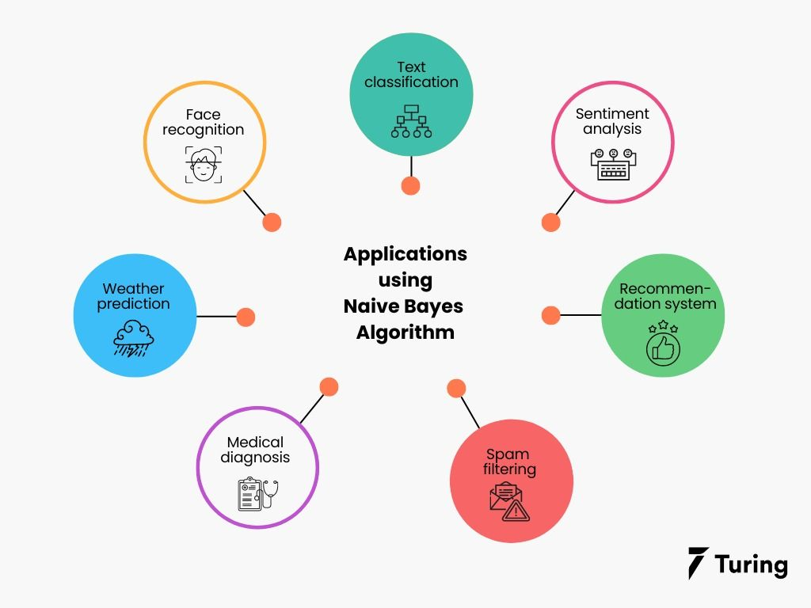
Things We’d Like to Do
Spam Classification
  Given an email, predict whether it is spam or not
Medical Diagnosis
  Given a list of symptoms, predict whether a patient has disease X or not
Weather
  Based on temperature, humidity, etc… predict if it will rain tomorrow

Slide 7
Why is it called Naïve Bayes?
The Naïve Bayes algorithm is comprised of two words Naïve and Bayes, Which can be described as:
Naïve: It is called Naïve because it assumes that the occurrence of a certain feature is independent of the occurrence of other features. Such as if the fruit is identified on the bases of color, shape, and taste, then red, spherical, and sweet fruit is recognized as an apple. Hence each feature individually contributes to identify that it is an apple without depending on each other.
Bayes: It is called Bayes because it depends on the principle of Bayes' Theorem.

Slide 8
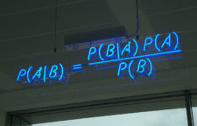

Bayes Formula :
How did we get this ?

Slide 9

Introducing Bayes theorem:
Bayes Theorem gives the conditional probability of an event A given another event B has occurred
Where:
P(A|B) = Conditional Probability of A given B
P(A|B) = Conditional Probability of B given A
P(A) = Probability of event A
P(B) = Probability of event B .

Slide 10
Bayesian Classification
Problem statement:
  Given features X1,X2,…,Xn
  Predict a label Y

Slide 11
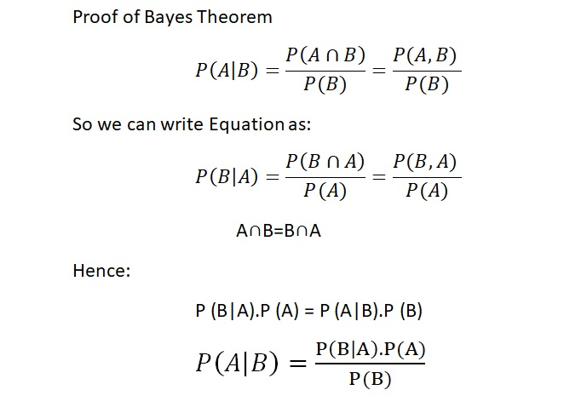
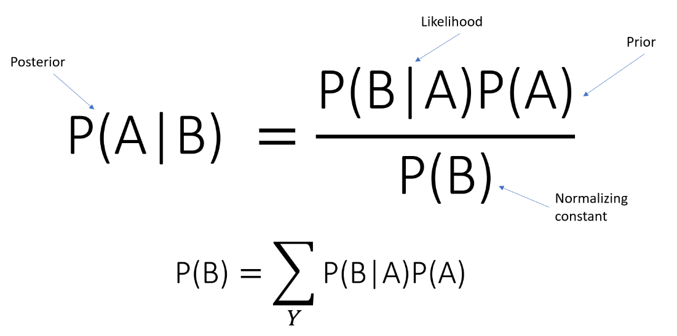
Bayes Formula :

Slide 12

The Bayes Classifier
A good strategy is to predict:
  (for example: what is the probability that the image represents a 5 given its pixels?)
So … How do we compute that?

Slide 13
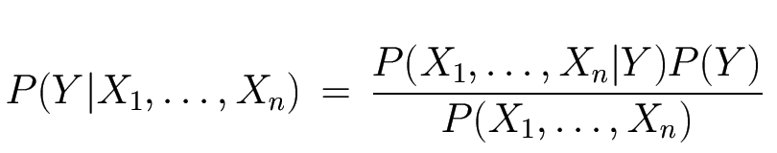
The Bayes Classifier
Use Bayes Rule!
Why did this help? Well, we think that we might be able to specify how features are “generated” by the class label
Likelihood
prior
Normalization Constant

Slide 14
Model Parameters
For the Bayes classifier, we need to “learn” two functions, the likelihood and the prior
How many parameters are required to specify the prior for our digit recognition example?

Slide 15
Model Parameters
The problem with explicitly modeling P(X₁,…,X_{n}|Y) is that there are usually way too many parameters:
  We’ll run out of space
  We’ll run out of time
  And we’ll need tons of training data (which is usually not available)

Slide 16
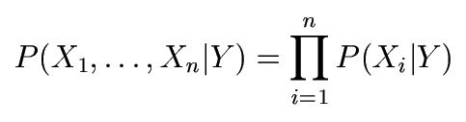
The Naïve Bayes Model
The Naïve Bayes Assumption: Assume that all features are independent given the class label Y
Equationally speaking:
(We will discuss the validity of this assumption later)

Slide 17
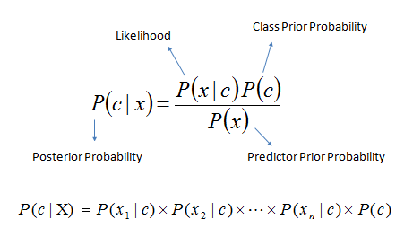
Introduction – Bayes theorem
P(c|x) – the posterior probability of class(c, target) given predictor (x, attributes).
P(c) – the prior probability of class
P(x|c ) – is the likelihood which of the probability of predictor given class
P(x) – is the prior probability of predictor

Slide 18
Working of Naïve Bayes' Classifier:
Working of Naïve Bayes' Classifier can be understood with the help of the below example:
Suppose we have a dataset of weather conditions and corresponding target variable "Play". So using this dataset we need to decide that whether we should play or not on a particular day according to the weather conditions. So to solve this problem, we need to follow the below steps:
Convert the given dataset into frequency tables.
Generate Likelihood table by finding the probabilities of given features.
Now, use Bayes theorem to calculate the posterior probability.

Slide 19
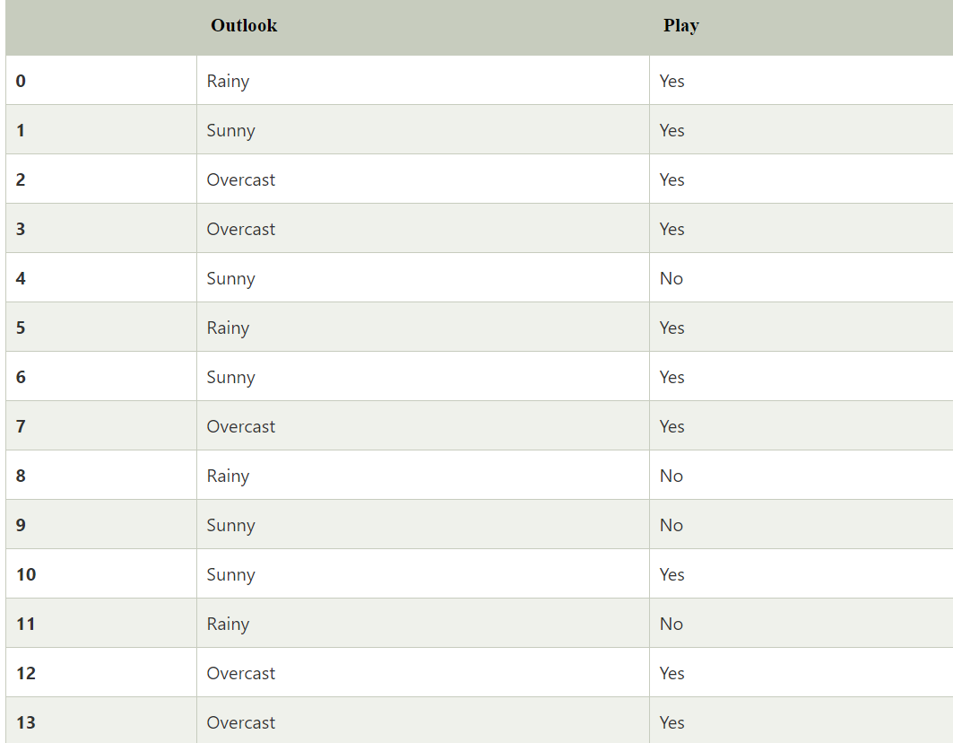
Problem: If the weather is sunny, then the Player should play or not?
Solution: To solve this, first consider the below dataset

Slide 20
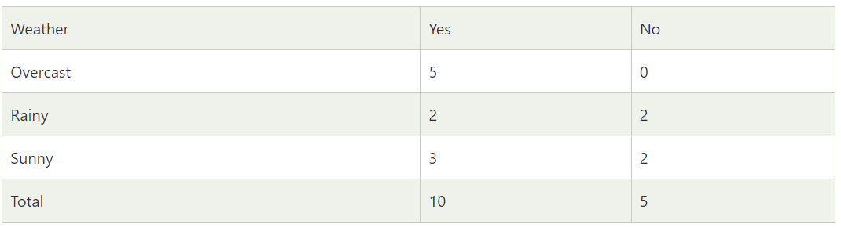
Frequency Table for the weather conditions:

Slide 21
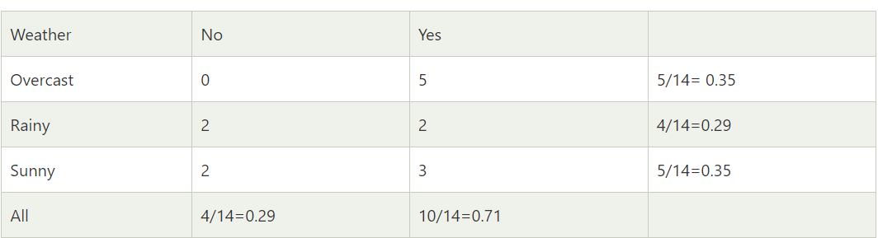
Likelihood table weather condition:

Slide 22
Applying Bayes theorem:
P(Yes|Sunny)= P(Sunny|Yes)*P(Yes)/P(Sunny)
P(Sunny|Yes)= 3/10= 0.3
P(Sunny)= 0.35
P(Yes)=0.71
So P(Yes|Sunny) = 0.3*0.71/0.35= 0.60

Slide 23
P(No|Sunny)= P(Sunny|No)*P(No)/P(Sunny)
P(Sunny|NO)= 2/4=0.5
P(No)= 0.29
P(Sunny)= 0.35
So P(No|Sunny)= 0.5*0.29/0.35 = 0.41
So as we can see from the above calculation that P(Yes|Sunny)>P(No|Sunny)
Hence on a Sunny day, Player can play the game.

Slide 24
Types of Naïve Bayes Model:
There are three types of Naive Bayes Model, which are given below:
Gaussian : In Gaussian Naïve Bayes, continuous values associated with each feature are assumed to be distributed according to a Gaussian distribution (Normal distribution). When plotted, it gives a bell-shaped curve which is symmetric about the mean of the feature values
Multinomial: This is mostly used for document classification problem, i.e whether a document belongs to the category of sports, politics, technology etc. The features/predictors used by the classifier are the frequency of the words present in the document.
Bernoulli : This is similar to the multinomial naive bayes but the predictors are boolean variables. The parameters that we use to predict the class variable take up only values yes or no, for example if a word occurs in the text or not.

Slide 25
Advantages of Naïve Bayes Classifier:
Naïve Bayes is one of the fast and easy ML algorithms to predict a class of datasets.
It can be used for Binary as well as Multi-class Classifications.
It performs well in Multi-class predictions as compared to the other Algorithms.
It is the most popular choice for text classification problems.

Slide 26
Disadvantages of Naïve Bayes Classifier:
Naive Bayes assumes that all features are independent or unrelated, so it cannot learn the relationship between features.
As the features are highly correlated, it affects the model performance negatively.

Slide 27
Applications of Naïve Bayes Classifier:
It is used for Credit Scoring.
It is used in medical data classification.
It can be used in real-time predictions because Naïve Bayes Classifier is an eager learner.
It is used in Text classification such as Spam filtering and Sentiment analysis.

Slide 28
Naïve Bayes Assumption
The key assumption of independence of features, is almost never true
Still Naïve Bayes does surprisingly well in a lot of situations
It works best when all the predictor variables are categorical variables.
Very frequently used in text mining, character image

Slide 29
Python Implementation of the Naïve Bayes algorithm:
Now we will implement a Naive Bayes Algorithm using Python. So for this, we will use the "user_data" dataset, which we have used in our other classification model. Therefore we can easily compare the Naive Bayes model with the other models.
Steps to implement:
Data Pre-processing step
Fitting Naive Bayes to the Training set
Predicting the test result
Test accuracy of the result(Creation of Confusion matrix)
Visualizing the test set result.

Slide 30


